Slide 1
HR ATTRITION DRIVERS
ANALYSIS OF KEY TURNOVER FACTORS FOR THE COMPLANY ANALYSIS

Slide 2
CONTEXT AND THE PROBLEM
Title: Our Current Attrition Status
Objective:
To identify the primary, hidden drivers of employee turnover and propose strategic, data-driven interventions.
Key Metric:
Overall Attrition Rate: 16.12%
Total Employee Count: 1,470
Key Text: “Our goal is not just to report the rate, but to understand who is leaving, why they are leaving, and when they are most likely to leave.”

Slide 3
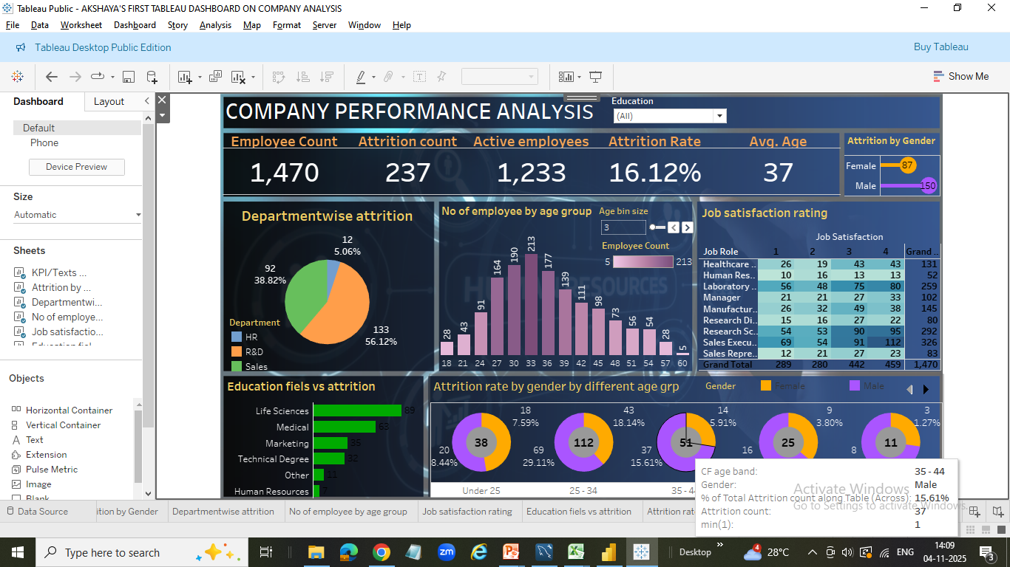
FINDINGS
FINDING 1:
Attrition Spikes in Specific Age
& Gender Cohorts.
Chart Used:
Attrition Rate by Age Group and Gender.
Key Takeaway:
Age Group with the highest combined rate (e.g., 26-35).
Data Point 1:
The [Age Group, e.g., 26-35] cohort is our highest flight risk, representing [X]% of all turnover.
Data Point 2: Within this group, [Gender, e.g., Male] employees are leaving at a rate of [X]% compared to [Y]% for [Gender, e.g., Female] employees.

Slide 4
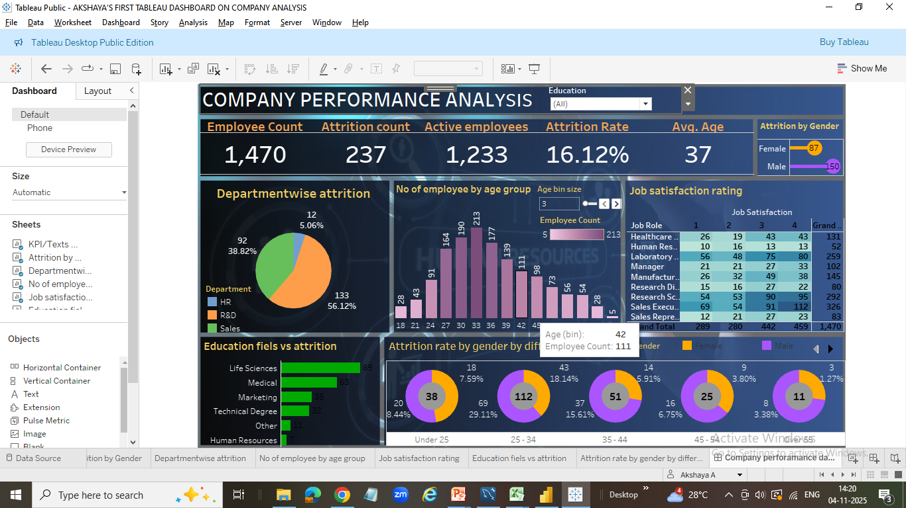
Finding 2:
High Mobility in Specialized Education Fields.
Key Takeaway
Life Science and Medical are the top 2
educational fields with Highest attrition.
Data Point 1:
Attrition is notably high in [Education Field 1, e.g., Life Sciences] at [X]% and [Education Field 2, e.g., Medical] at [Y]%.
Data Point 2:
In contrast, fields like [Lowest Attrition Field, e.g., Technical Degree] show significantly lower turnover.

Slide 5
Finding 3:
High Turnover in New Hires & Low Earners.
Key Takeaway:
Focus on short tenure and low income as separate, but related, major causes.
Tenure Risk:
Employees with less than 2 years of service have a turnover rate that is [e.g., 2.5X] the company average.
Income Risk:
Attrition peaks in the lowest income quartile (e.g., Monthly Income $<\$4,000$).

Slide 6
SYNTHESIS: ROOT CAUSES OF ATTRITION
Three Structural Drivers of Attrition:
Driver 1 (Cohort)Mid-Career Male Employees (Age 26-35):
Likely seeking higher-paying roles for career acceleration.
Driver 2 (Engagement)Low-Tenure Employees (<2 Years):
Indicative of poor initial fit, inadequate onboarding, or early dis-satisfaction.
Driver 3 (Market Demand)Specialized Fields (Life Sciences/Medical):
Suggests we are losing employees to external competitors who offer better packages.

Slide 7
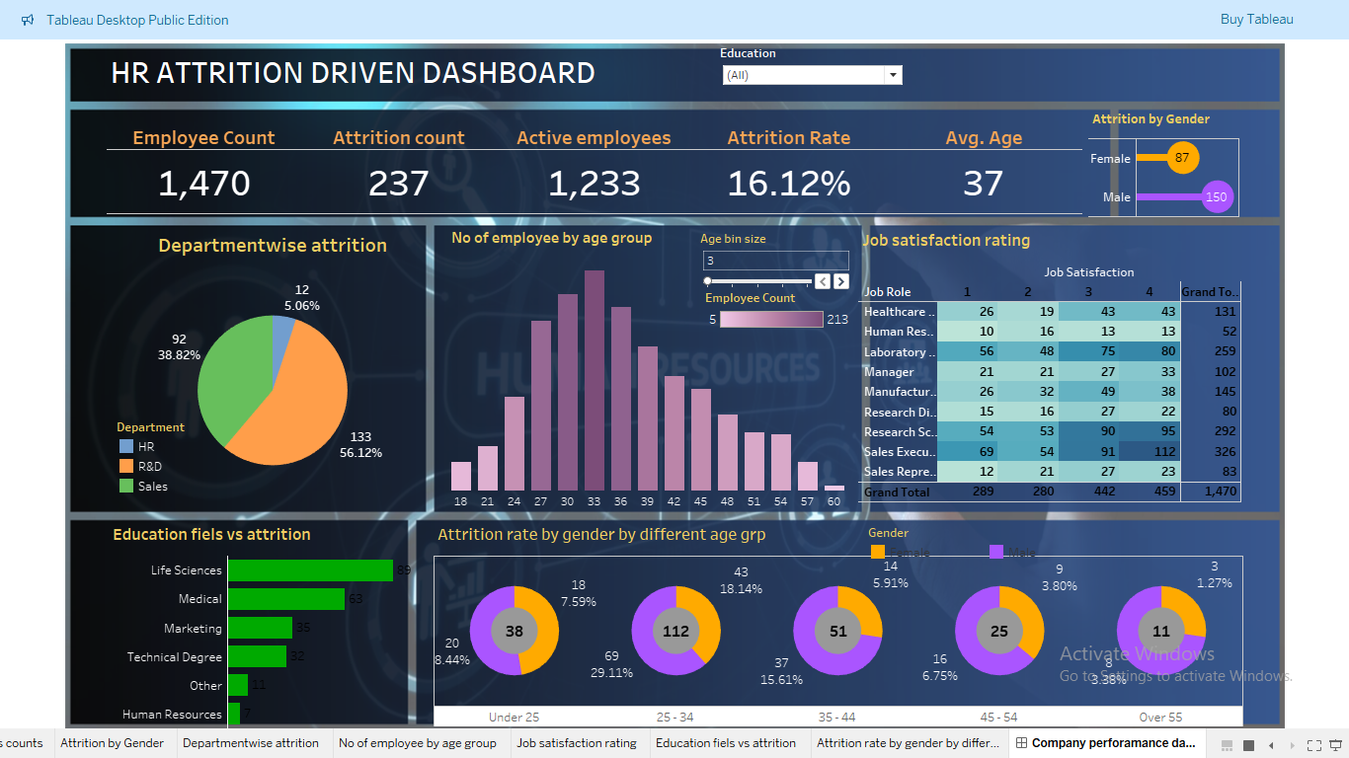
HR ATTRITION DRIVERS DASHBOARD

Slide 8
ACTIONABLE RECOMMENDATIONS
Targeted Compensation Review:
Conduct an immediate salary band review for the [Age Group/Gender] cohort to close competitive gaps and retain experienced talent.
Enhanced Onboarding & Mentorship:
Implement a formal, mandatory mentorship program for all new hires (Year 1) to drastically reduce the turnover spike in the <2 year tenure group.
Exit Interview Deep Dive:
Launch a study using exit interview data focused on employees in the high-attrition education fields to identify non-salary motivators (e.g., work-life balance, project scope) for leaving.

Slide 9
GITHUB LINK

